Slide 1




DIGITAL LITERACY
SKILLS
BASIC USERS

Slide 2
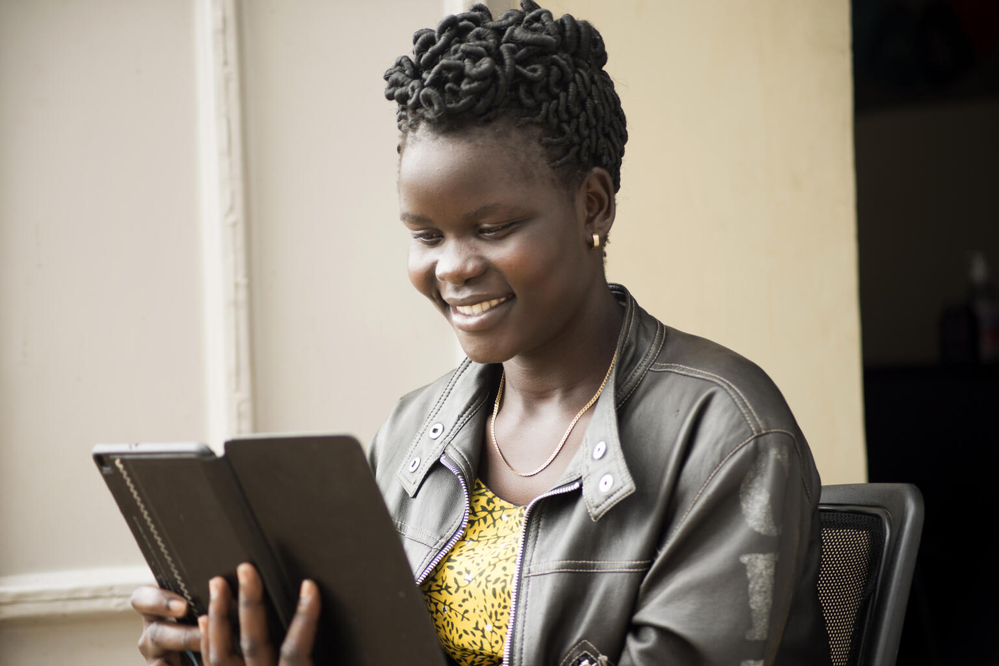
Module 2
Information processing

Slide 3

3
Unit 3: Managing data, information and digital content

Slide 4

Devices to save and retrieve information
Memory and Storage Devices
ROM (Read Only Memory)
RAM (Random Access Memory)
Memory card
USB Stick
Internal hard drive
External hard drive
Cloud storage

Slide 5
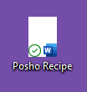
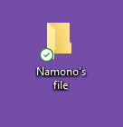
Skills to practise
Save or store files and retrieve then after they have been saved.
Save your favourite posho recipe.
Create a simple folder structure for saved files.
Create a file with your name.

Slide 6
All back covers should include
contact information of the section
producing the work.
© United Nations Children’s Fund (UNICEF) [month and year of publication]

